Slide 1
Sexually Transmitted Diseases

Slide 2
Introduction
Sexually transmitted diseases (STD), also referred to as sexually transmitted infections (STI) and venereal diseases (VD), are illnesses that have a significant probability of transmission between humans by means of sexual behaviour, including vaginal intercourse, anal sex and oral sex.
Some STIs can also be contracted by using drug needles after their use by an infected person, as well as through any incident involving the contact of a wound with contaminated blood or through childbirth or breastfeeding.

Slide 3
Sexually Transmitted Diseases (STDs)
Sexually Transmitted Diseases (STDs) are diseases passed from one person to another during sexual activity.
STDs can be serious, painful and may have long term effects, especially if left undetected and untreated.
They infect your sexual and reproductive organs.

Slide 4
The symptoms
Sores (either painful or painless)
Blood in urine
Burning sensation when urinating
Rashes
Itching
wart
Unusual discharge

Slide 5
Most common STDs:
Bacterial STDs like gonorrhea, chlamydia and syphilis, are relatively easy to cure with antibiotics if detected and treated.
Viral: Genital herpes, genital warts, Hepatitis B and HIV are viral infections that cannot be cured, but the symptoms can be treated and managed.
Parasites: Crab louse- known as crabs or pubic lice.

Slide 6
Types of Sexually Transmitted Diseases
Bacterial | Viral | Parasitic
Chlamydia Gonorrhea Syphilis | HPV (Genital Warts) HIV Herpes Hepatitis B | Pubic Lice (“crabs”) Trichomoniasis

Slide 7
Chlamydia
What is it? How do you get it? | How do you know you have it? | Testing and Treatment
A sexually transmitted infection caused by the bacteria Chlamydia trachomatis. You can get it through unprotected oral, vaginal, or anal sex. | 70% of women and 10% of men have no symptoms. Women may notice: more vaginal discharge or itchiness, bleeding between periods or during sex, lower abdominal pain, or pain during intercourse or while urinating. Men may notice: discharge from the penis, burning during urination, itching around the opening of the penis, or pain in the testicles. | You can be tested through a simple urine test or a swab taken during a Pap test (females only). Chlamydia is cured by one dose of antibiotics, but takes about 7days to clear the infection. It is important not to have sex while the cure is working because you may infect your partner or become re-infected yourself. Your partner(s) will need to be tested and treated for chlamydia also.

Slide 8
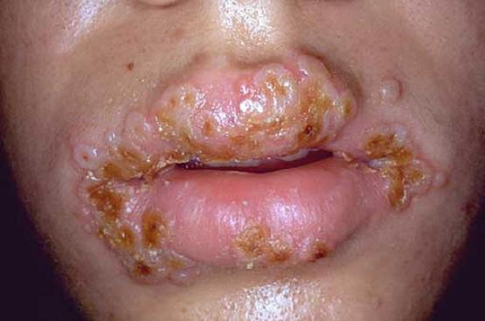
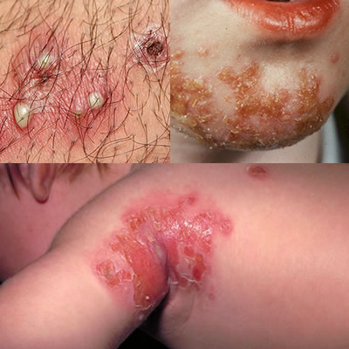
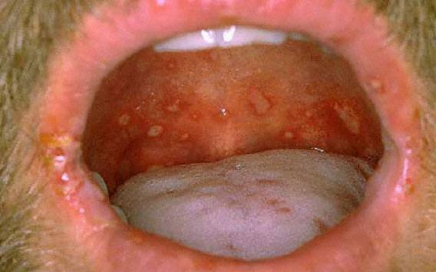
Chlamydia

Slide 9
Gonorrhea
What is it? How do you get it? | How do you know you have it? | Testing and Treatment
A sexually transmitted infection caused by the bacteria Neisseria gonorrhoeae. You can get it through unprotected oral, vaginal or anal sex. It can infect the penis, rectum, throat, eyes, and cervix. | You may have this infection and not even know it. Women may notice an increase in vaginal discharge, bleeding between periods, bleeding or pain during sex, pain in the abdomen or pain while urinating. Men may notice burning while urinating, thick greenish-yellow discharge from the penis or pain in the testicles. | You can be tested through a simple urine test or a swab taken during a Pap test (females only). It is cured by one dose of antibiotics, but takes about 7days to clear the infection. It is important not to have sex while the cure is working because you may infect your partner or become re-infected yourself. Your partner(s) will need to be tested and treated for chlamydia also.

Slide 10
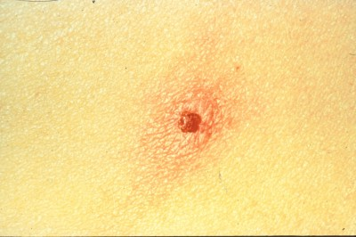
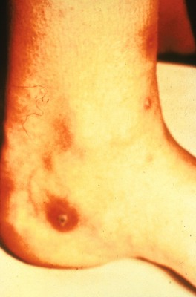
Gonorrhea

Slide 11
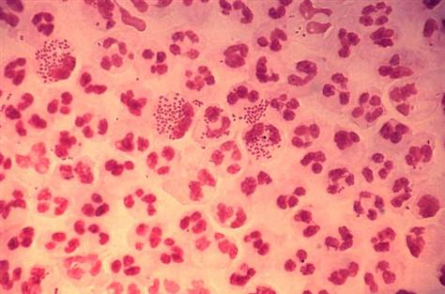
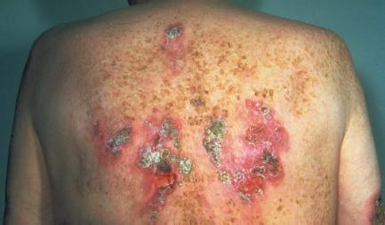
Gonorrhea
Infectious bacterial infection of reproductive organs
Caused by Neisseria gonorrhoeae
2nd major STD
75% of gonorrhea cases are in age group of 15-30.

Slide 12
Syphilis
What is it? How do you get it? | How do you know you have it? | Testing and Treatment
A sexually transmitted infection caused by the bacteria Treponema palladium. You can get it through unprotected oral, vaginal or anal sex. | The first symptom of syphilis is a chancre (painless sore) at the point of infection. Stage two is usually a rash on the body, especially on the hands and feet. Stage three may last 20-30 years and can cause damage of the heart, brain, and other organs, it may also eventually cause death. | You can be tested through a special blood test. Syphilis is treated with antibiotics, usually penicillin. Once you have been treated, you need to get a blood test to make sure you have been cured. Your sexual partner(s) will also need to be tested and treated.

Slide 13
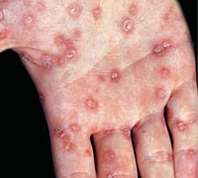
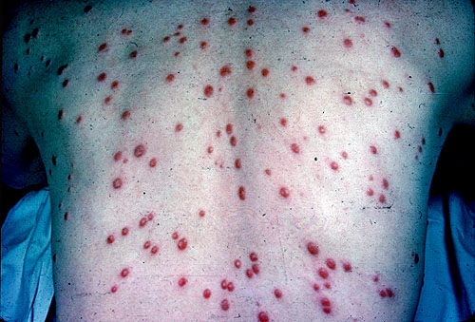
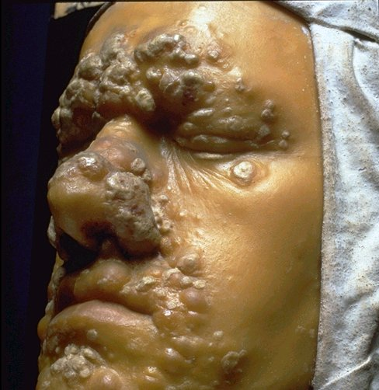
Primary
Secondary
Tertiary
Syphilis
Contagious, STD caused by spirochete – Treponema pallidum
Primary, Secondary, Tertiary
Neuropathy
Heart failure
Blindness
Memory loss
Insanity
Death

Slide 14
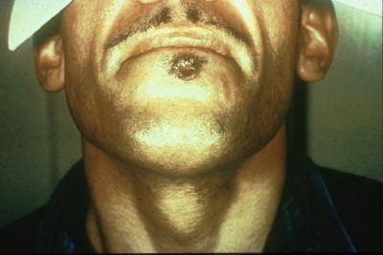
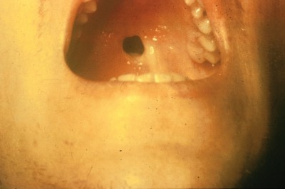
Syphilis –
1st Stage

Slide 15
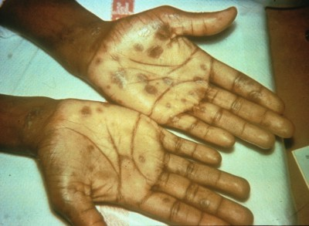
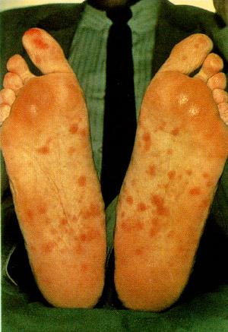
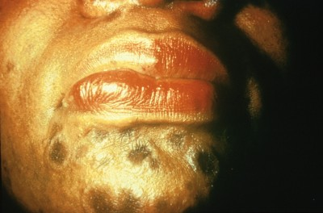
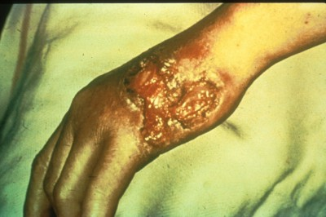
Secondary Stage

Slide 16
HPV
What is it? How do you get it? | How do you know you have it? | Testing and Treatment
A sexually transmitted viral infection caused by the Human Papillomavirus. It may cause genital warts or lead to cervical cancer. You can get it through unprotected oral, vaginal, or anal sex or from sexual activities with skin-to-skin contact. | You can pass on this virus without even knowing that you have it. If infected, it may cause warts on the genitals or rectum that look like flesh coloured cauliflower. It may also cause itchiness, discomfort and/or bleeding during sex. | A doctor or nurse can diagnose warts by looking at them. The virus may cause changes to the cervix and be checked during a Pap test (females). Treatment includes burning, freezing or surgically removing the warts. A special doctor (gynecologist) may follow-up with you if there are changes to your cervix (females).

Slide 17
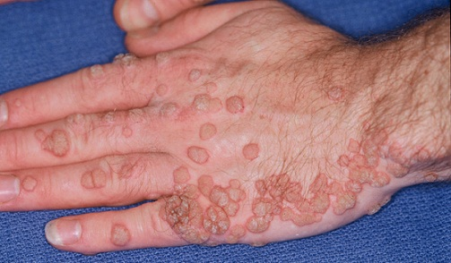
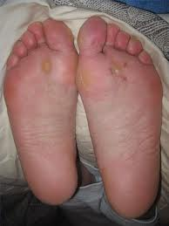
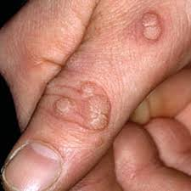

HPV

Slide 18
Hepatitis B
What is it? How do you get it? | How do you know you have it? | Testing and Treatment
A viral infection that damages the liver. It can be transmitted through the exchange of bodily fluids (semen, vaginal fluid, blood). You can get it through unprotected oral, vaginal, or anal sex or through exposure to blood or blood products. | Hepatitis B infection may cause you to feel tired or have pain in your abdomen. You may have nausea and vomiting and/or fever and chills. You may also notice that your skin or the whites of your eyes look yellowish. Your urine and stool may look a strange colour. You may also have no symptoms at all. | You can be tested through a special blood test. Most people with this virus can fight it off with rest and healthy lifestyle changes within 6 months. While you are actively infected, you can pass it on to others. After your body has fought off the infection, you are protected from ever getting the virus again and from passing it on to others.

Slide 19
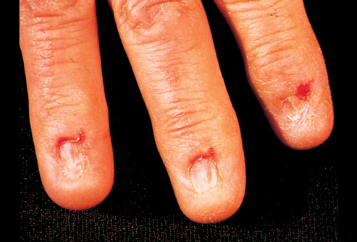
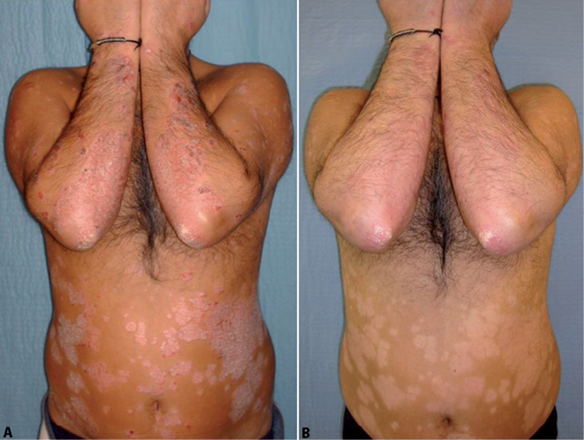
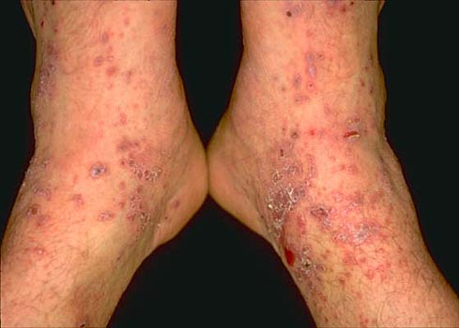
Hepatitis B

Slide 20
Herpes
What is it? How do you get it? | How do you know you have it? | Testing and Treatment
This viral infection is caused by the herpes simplex virus (types 1 and 2). You can get it through direct oral, vaginal, or anal sex or from skin-to-skin contact. If infected you can get sores that return weeks, months, or years later. You may get this virus in your eyes, mouth or genitals. | Not all people infected with herpes will develop symptoms. If symptoms do develop, they will begin with a tingling or burning sensation on the skin, turning into blisters and sores. During the outbreak, you may also feel like you have the flu with fever, muscular pain and tender lymph nodes. | A doctor or nurse can check the sores and take swabs of the fluid in the sores to diagnose the infection. A herpes infection cannot be cured but it can be managed. Medications (antivirals) can help prevent outbreaks of blisters and sores or reduce the length of time that you have them.

Slide 21
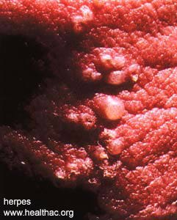
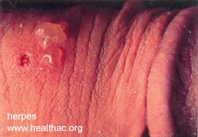
Herpes

Slide 22
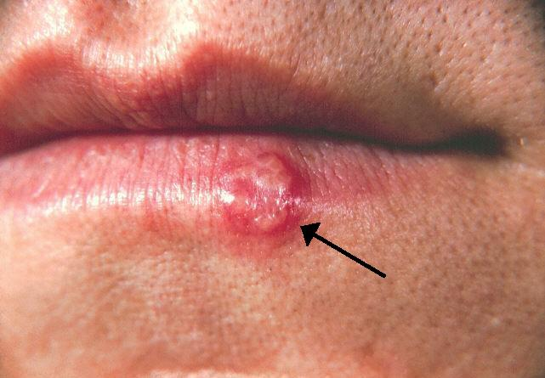
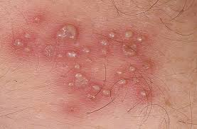
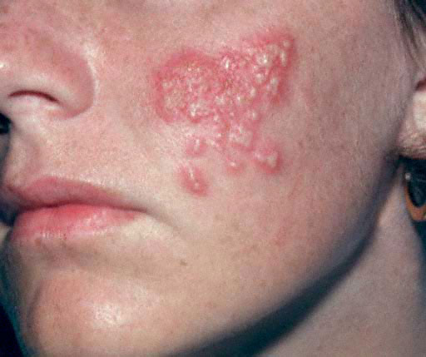
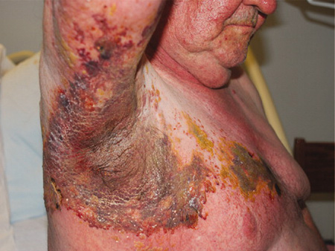

Slide 23
HIV
What is it? How do you get it? | How do you know you have it? | Testing and Treatment
HIV is the virus that causes AIDS and attacks your immune system, leaving it vulnerable to other infections. You can get the virus through an exchange of blood, vaginal fluid, semen and breast milk. It cannot be passed on through touching, hugging, kissing or other casual contact. | You may have this virus without having any symptoms for years. You may develop mild flu-like symptoms 2-4 weeks after being infected. Once the immune system is weakened, you may develop: frequent fever or sweats, skin rashes, swollen glands, sore throat, fatigue, headaches, rapid unexplained weight loss, and nausea/vomiting and diarrhea. | You can be tested through a special blood test. However, it takes 3 months for the infection to be detectable. HIV cannot be cured and may lead to AIDS. Treatment for the infection is different for everyone, but includes medications called antiretrovirals and medications to prevent other infections from harming the person.

Slide 24
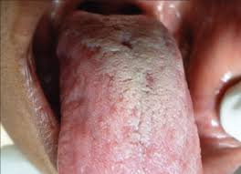
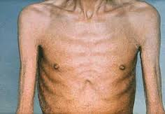
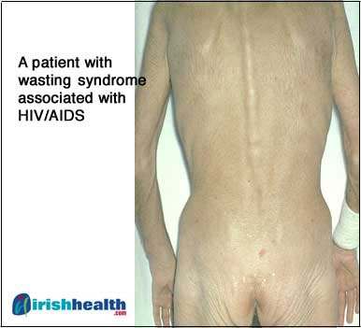
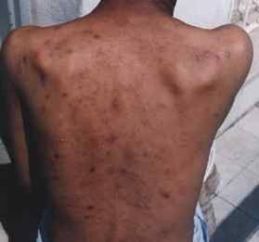
HIV

Slide 25
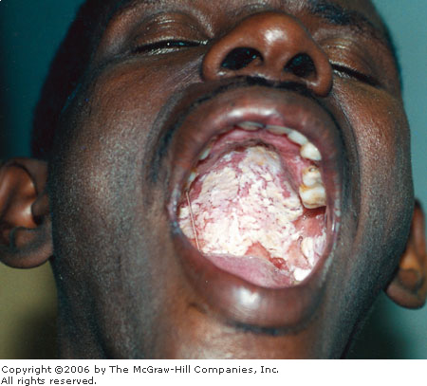
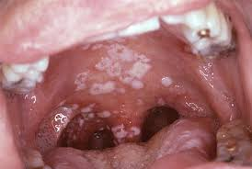
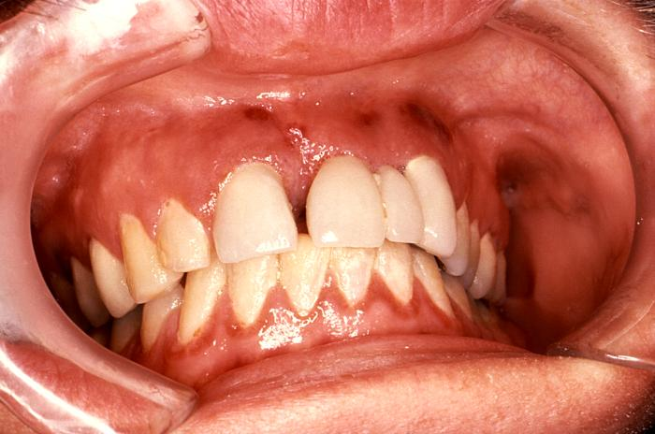

Slide 26
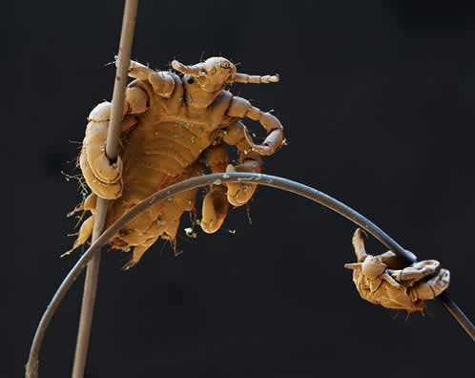
Pubic Lice
Parasitic insects in genital area
Common and worldwide.
Spread through sex contact only.
Infection may indicate sexual activity.

Slide 27

Prevention Of STD’s And STI’s
1. Counseling and behavioral interventions offer primary prevention against STIs (including HIV), as well as against unintended pregnancies.
2. Comprehensive sexuality education, STI and HIV pre- and post-test counseling.
3. Safer sex/risk-reduction counseling, condom promotion.
4. Think about your alcohol and drug use.

Slide 28
Prevention
Abstinence
Know your partner
Limit your partners
Visit your doctor
Always look
Keep clean!

Slide 29
Reducing Risks
If an infection is detected, it is recommended that the infected individual and their partner(s) abstain from sexual activity until treatment is complete, symptoms have subsided, and the infection is cured (when applicable).

Slide 30
Remember:
3 million teens contract an STD each year – some of which have no cure, are a leading cause of cervical cancer or can even lead to infertility.

Slide 31

Why should we worry on all these if our sex partner is a healthy person?
A microbe non-pathogenic to a person may be pathogenic on another.!

Slide 32
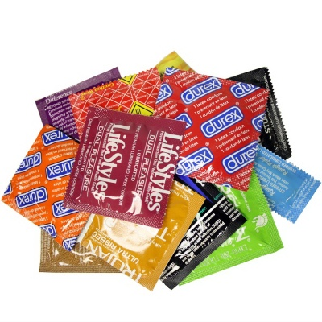
Why should we worry of all these, if we use condoms?

Slide 33
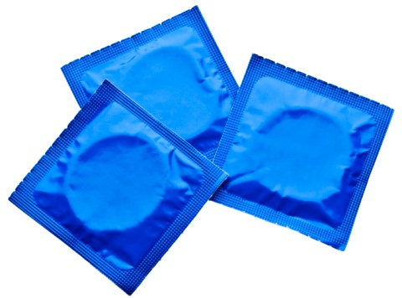
Are condoms safe?
Absolutely NOT…!
Using condoms to prevent AIDS is like playing Russian Roulette
According to US Centre for Disease Control, failure rate is 10-30%

Slide 34
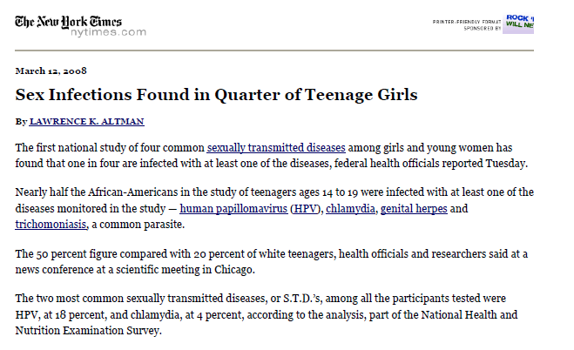
If condoms are safe, why the number is increasing?

Slide 35
If sperms can escape, how much easier for STDs and Viruses?
“The HIV virus is 50 times smaller than the sperm and 50 times smaller than the voids in rubber. Virus can easily pass through condom.”
- Dr. C.M. Ronanld, Editor, Rubber Chemistry and Technology

Slide 36
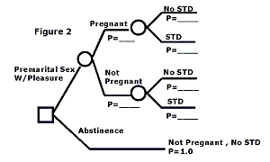

Slide 37
If we know that if we start the car and it has a 50% chance of exploding and killing whoever is inside, Will we start the engine?
What about 10% chance?

Slide 38
Teen Years
A time to study and learn.
Think about what I will do in the future.
To develop friendship.
To grow into the kind of person you want to be in the future.

Slide 39

Exciting time to discover
the opposite sex.

Slide 40


Dating can be a lot of fun without sex!

Slide 41

Exploring friendship

Slide 42

Right and Wrong

Slide 43
Thank you

Slide 44


